Slide 1


Snort IDS + Wazuh SIEM
Network Intrusion Detection & Security Event Monitoring
Group members:
Hamna Saleem
Bisma Safdar
Mushahaid Niaz
Shabbar Hussain
Salman Khan
Presented To: Miss Mahnoor Gillani

Slide 2
Introduction & Objective
What is Snort?
What is Wazuh?
Open-source Network Intrusion Detection System (NIDS)
Monitors live traffic on a network interface
Matches packets against rules and generates alerts
Created by Martin Roesch, maintained by Cisco
Version used: Snort 2.9.20 GRE (Build 82)
Open-source SIEM (Security Information & Event Management)
Collects, indexes, and correlates security events
Provides a centralized dashboard for SOC analysts
Built-in decoders for Snort, Suricata, and more
Components: Manager, Indexer (OpenSearch), Dashboard
Lab Objective: Detect real network attacks launched from Kali Linux using Snort IDS and visualize them on the Wazuh SIEM dashboard in real time.

Slide 3
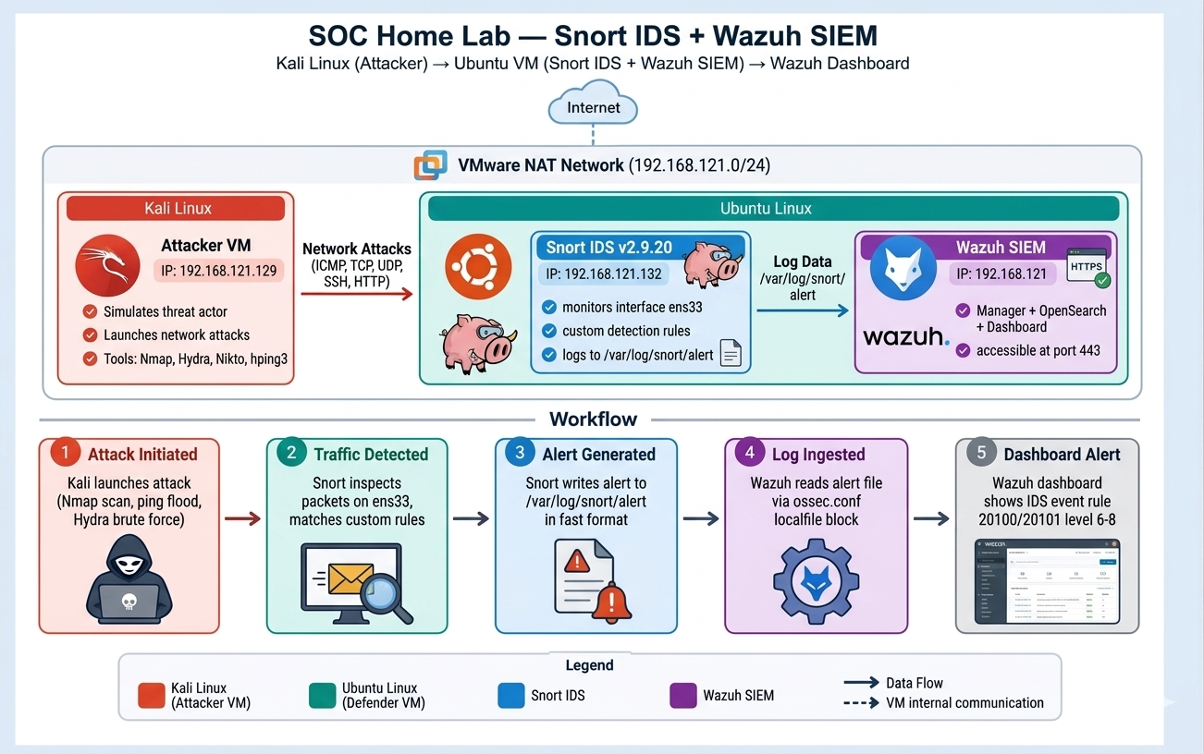
Network Architecture
1. Attack initiated
2. Traffic detected
3. Alert written
4. Log ingested
5. Dashboard alert

Slide 4
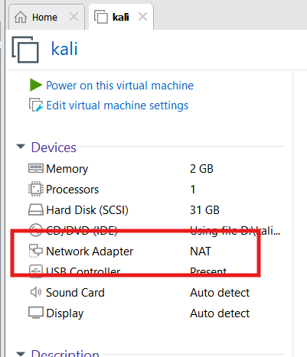
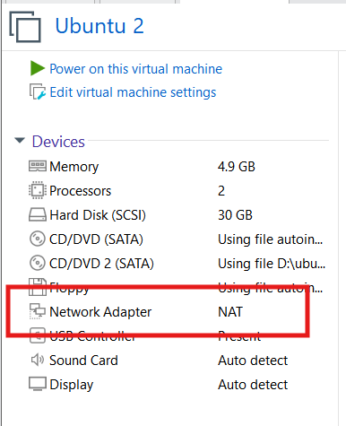
Network Settings of Both VMs
Kali Linux — Attacker VM
Ubuntu Linux — Defender VM
Network Adapter: VMware NAT
Network Adapter: VMware NAT
Interface
ens33 (eth0)
Interface
ens33
IP Address
192.168.121.129
IP Address
192.168.121.132
Subnet Mask
255.255.255.0
Subnet Mask
255.255.255.0
Subnet
192.168.121.0/24
Subnet
192.168.121.0/24
Gateway
192.168.121.2
Gateway
192.168.121.2
Role
Role
Snort IDS + Wazuh SIEM
Attacker / Threat Source
Both VMs are on the same VMware NAT subnet (192.168.121.0/24) — confirmed connectivity via ping before starting the lab.

Slide 5
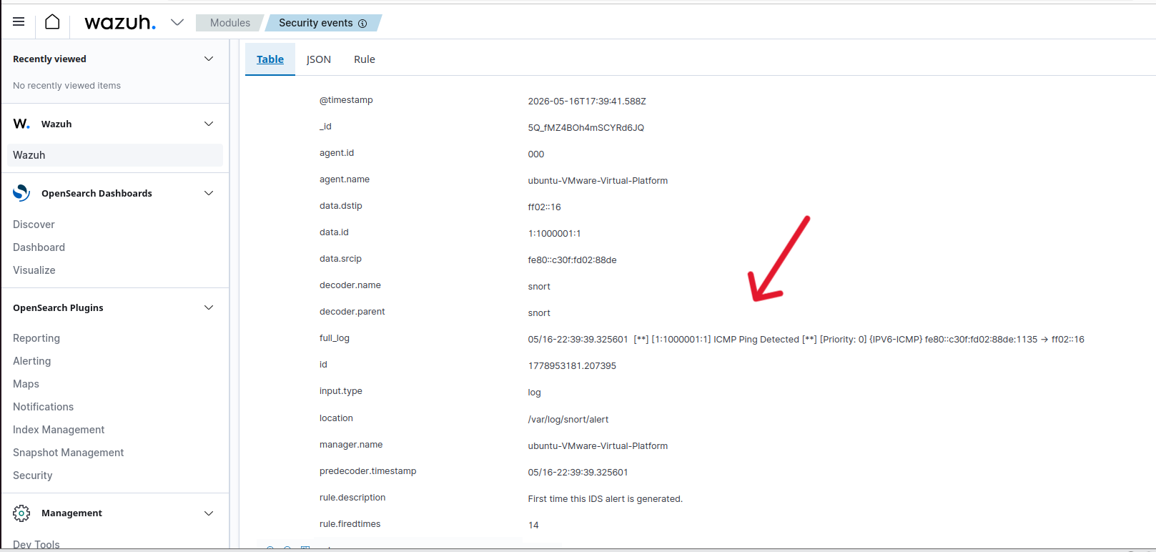
Attacks Performed — ICMP Flood
ICMP Flood
Tool: ping
sudo ping -f 192.168.121.132
What it does:
Floods target with ICMP echo requests. Simulates DoS attack. Snort captured 262,000+ ICMP packets.
Wazuh Alert
Wazuh Alert
Rule ID: 20100
Level: 6
IDS event — ICMP Ping Detected

Slide 6
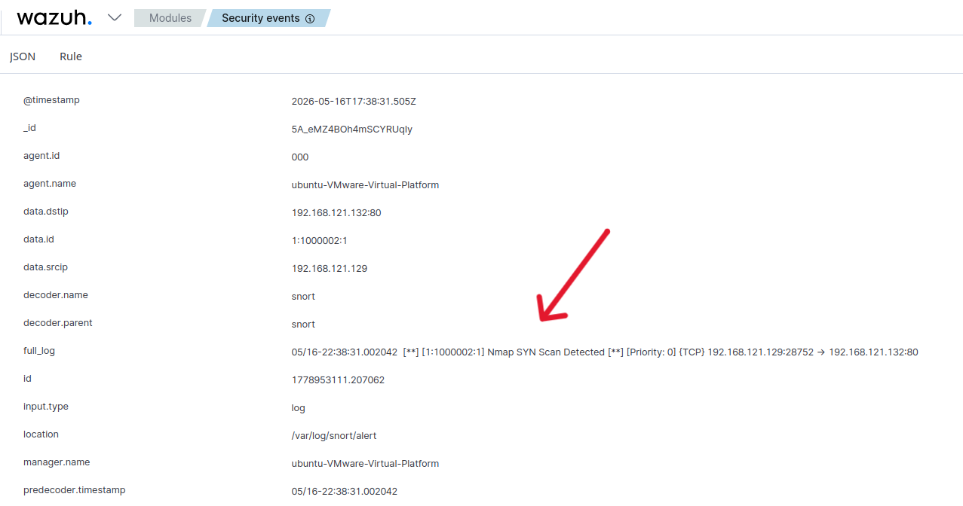
Attacks Performed — NMAP SYN Scan
Nmap SYN Scan
Nmap Aggressive
Tool: Nmap
sudo nmap -sS 192.168.121.132
What it does:
Sends SYN packets to every port without completing handshake. Discovers open services stealthily.
Wazuh Alert
Wazuh Alert
Wazuh Alert
Rule ID: 20101
Level: 6
IDS event — Nmap SYN Scan Detected

Slide 7
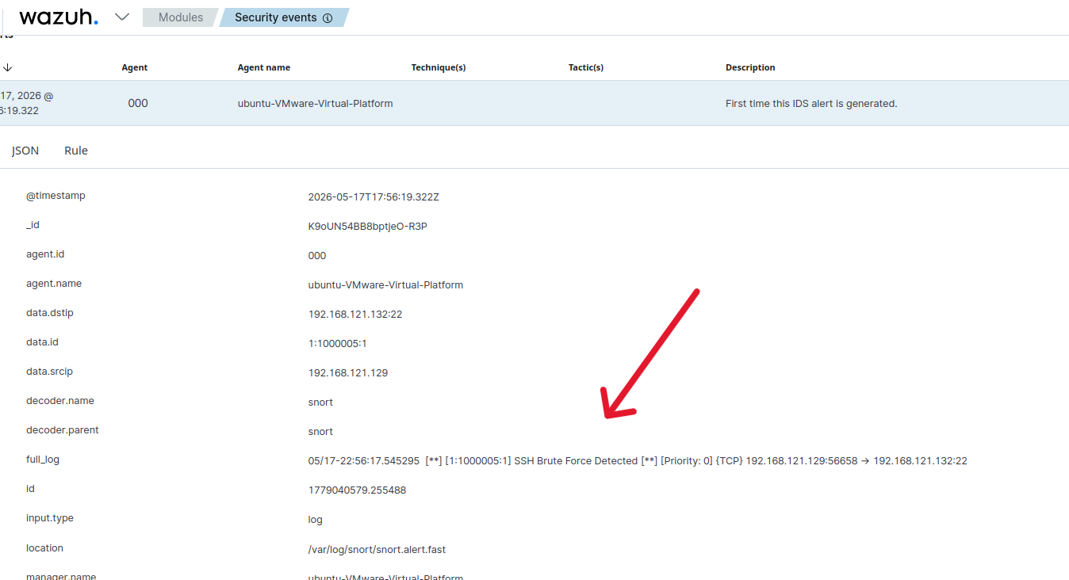
Attacks Performed — SSH Brute Force
Hydra SSH Brute Force
Tool: Hydra
sudo hydra -l root -P rockyou.txt 192.168.121.132 ssh -t 4
What it does:
Tries thousands of passwords from rockyou.txt wordlist against SSH port 22. Simulates a credential stuffing / brute force attack.
Wazuh Alert
Wazuh Alert
Rule ID: 1000005
Level: 8
First time this IDS alert — SSH Brute Force Detected

Slide 8
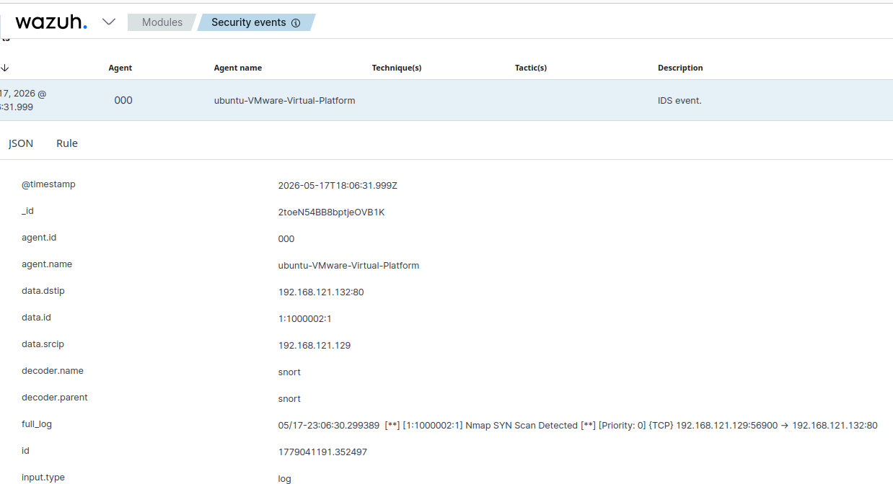
Attacks Performed — Nikto Web Scan
Nikto Web Scan
Hydra SSH Brute Force
Tool: Nikto
nikto -h http://192.168.121.132
What it does:
Scans web server for vulnerabilities, misconfigs, and dangerous files. Sends thousands of HTTP requests with 'Nikto' in the User-Agent header.
Wazuh Alert
Wazuh Alert
Rule ID: 20101
Level: 6
IDS event — Nikto Web Scan Detected

Slide 9
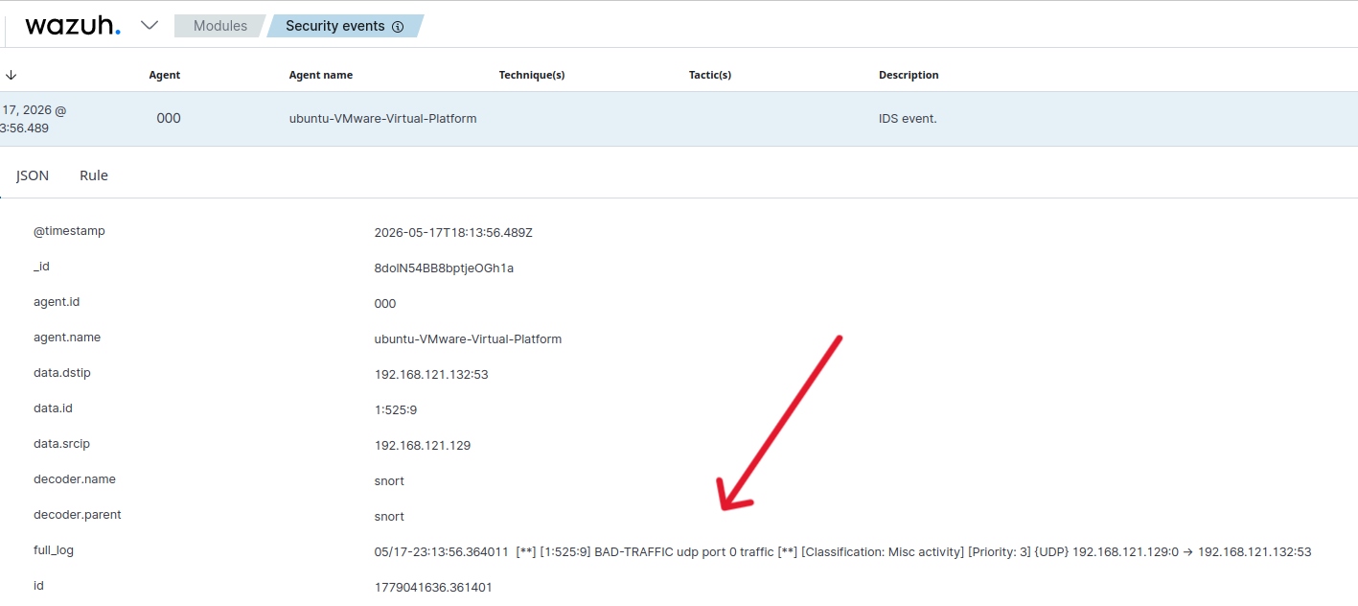
Attacks Performed — DOS Attack
DOS Attack
Xmas Scan
NULL / FIN Scan
Tool: hping3
sudo hping3 --udp -p 53 --flood 192.168.121.132
What it does:
Floods target with UDP/TCP packets. Simulates DDoS attack pattern targeting DNS port 53.
Wazuh Alert
Wazuh Alert
Wazuh Alert
Rule ID: 20101
Level: 6
IDS event — Bad Traffic Detected

Slide 10
Conclusion
What We Achieved
Tools Used
✓
Deployed Snort IDS on Ubuntu and wrote custom detection rules
Snort
IDS / packet inspection
✓
Launched 5 different attacks from Kali Linux targeting the Ubuntu VM
Wazuh
SIEM / dashboarding
✓
Integrated Snort with Wazuh SIEM via ossec.conf log monitoring
Nmap
Reconnaissance
✓
Visualized real-time IDS alerts on the Wazuh Security Events dashboard
Hydra
Brute force
✓
Generated a PDF incident report directly from the Wazuh dashboard
hping3 / Nikto
Flood / web scan
Real-world relevance: This lab mirrors a real SOC environment where Snort/Suricata feeds alerts into a SIEM platform like Wazuh, Splunk, or ELK Stack. Skills demonstrated — IDS rule writing, attack simulation, log integration, and alert triage — are core competencies for SOC Analyst and Penetration Tester roles.

